Slide 1
Prediction of Neonatal’s Heart Condition Using Cardiotocographic Observations
Rajesh Ranjan

Slide 2
Introduction
To predict the newborn health condition using various heart related observations obtained via Cardiotocography recordings.
Scope of Study:
Conduct Data Mining applied science to estimate the patient’s condition (1-Normal, 2-Suspected, 3-Pathological) based on the obtained heart related vital records.
Analysis Methodology (using R):
Decision Tree analysis-
Multinomial Regression Analysis-
Liner Discriminant Analysis-

Slide 3
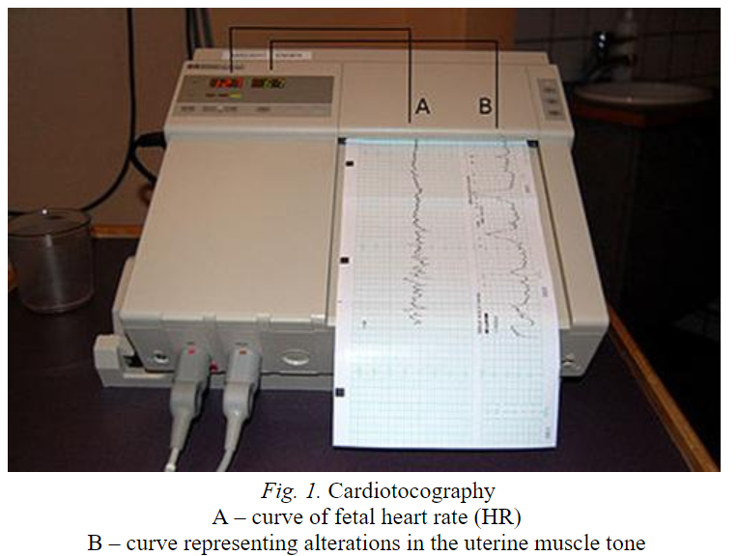
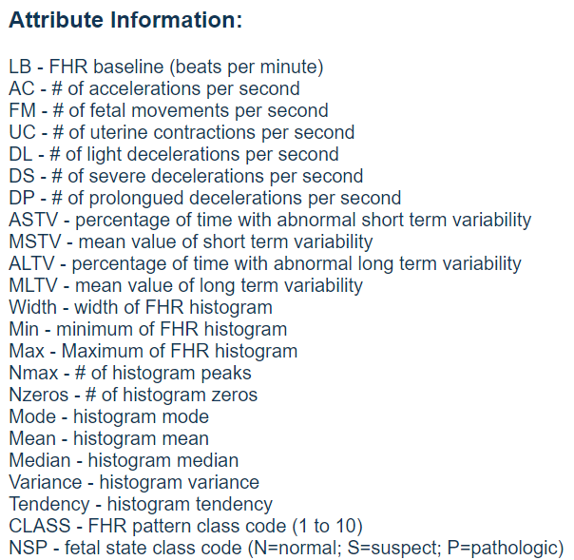
Dataset- Cardiotocography
Cardiotocography (CTG) –a graphic recording of fetal heart rate and uterine contractions for the assessment of Infant’s Heart condition.
Vital parameters for the study:
Independent Variable:
LB (FHR base Line per minute)
AC- Acceleration per second
FM- Fetal Movement per second
Categorical Variable
NSP- Fetal State (N- Normal, S-Suspected, P- Pathological)

Slide 4
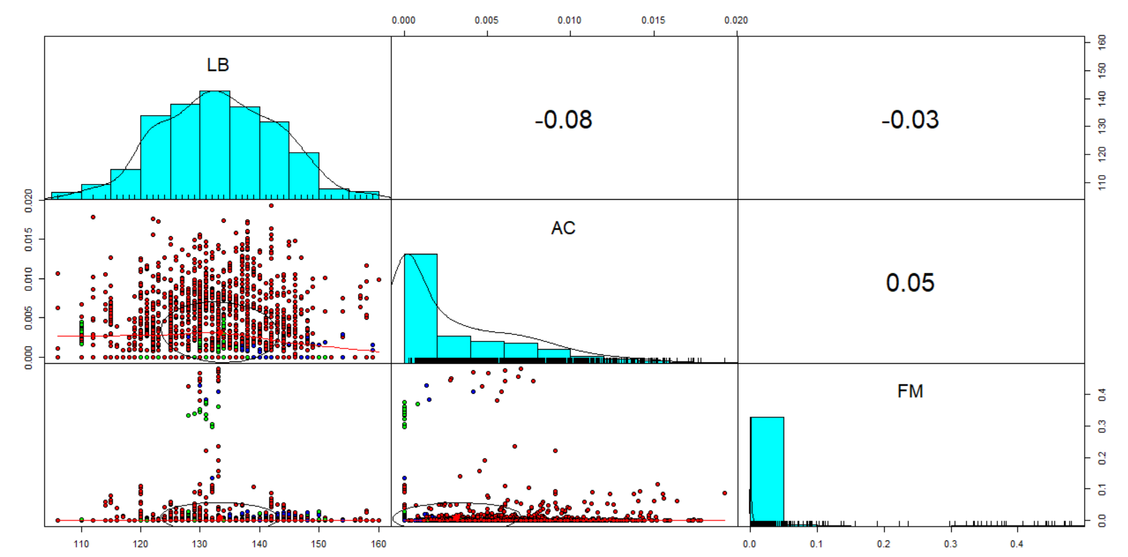
Data Preparation
2126 Observations, 22 parameters
Convert Numerical categorical variable to Factor type
Data Slicing [Training, Test] with 80:20 rule

Slide 5
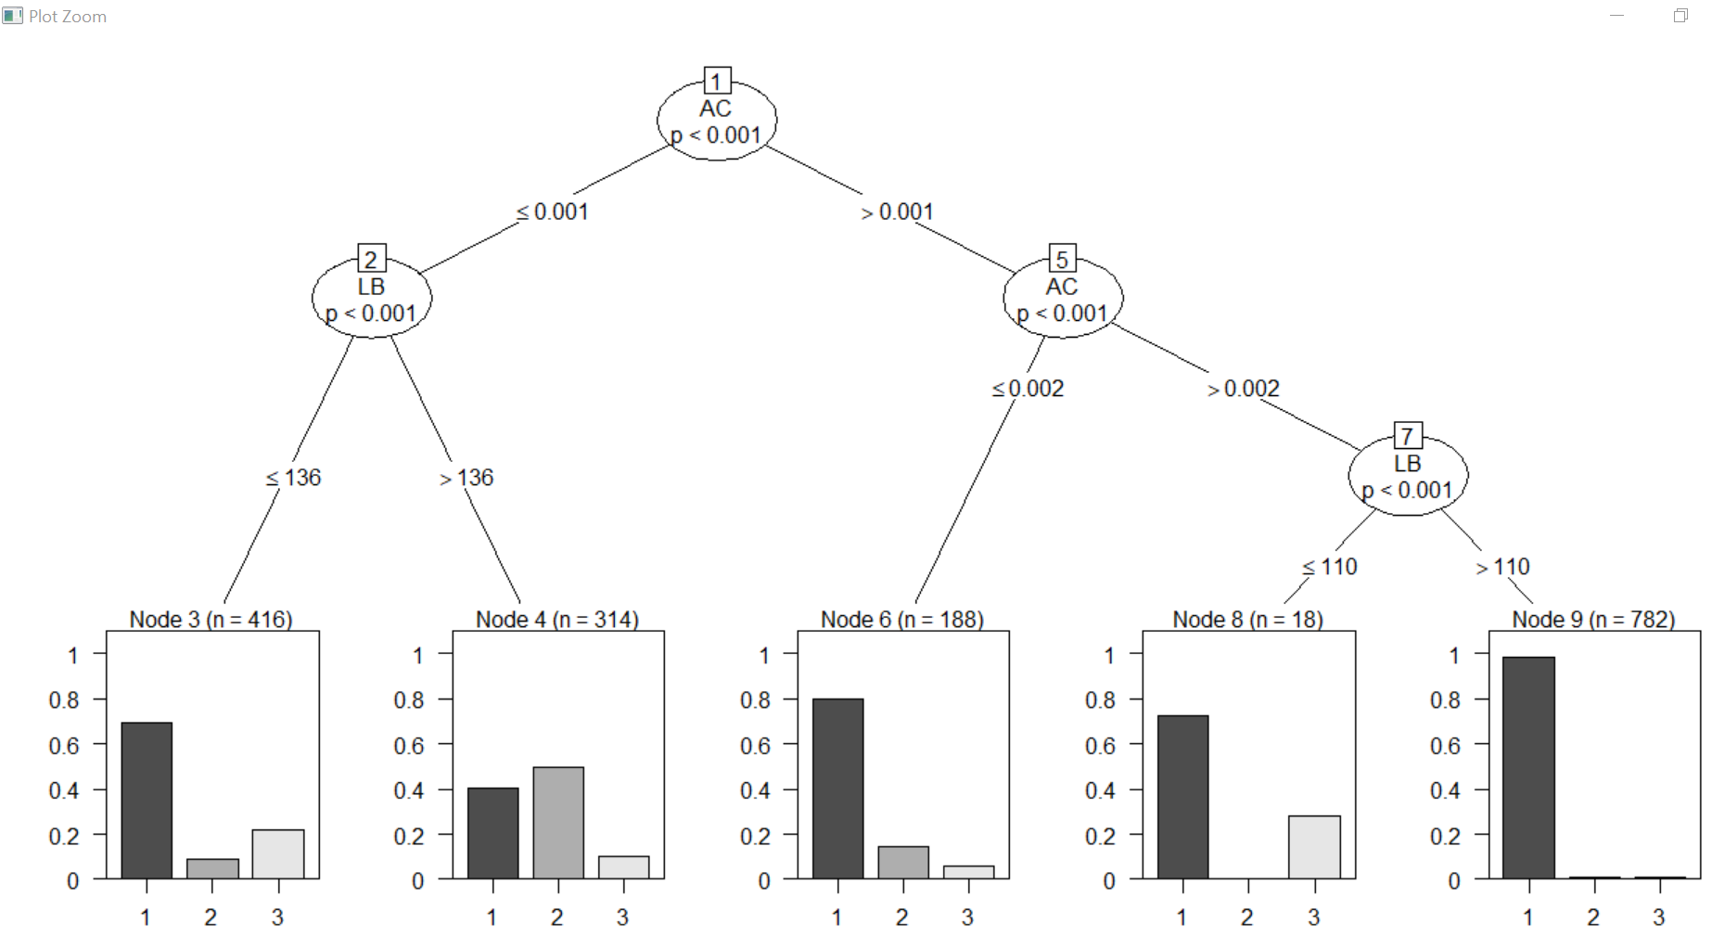
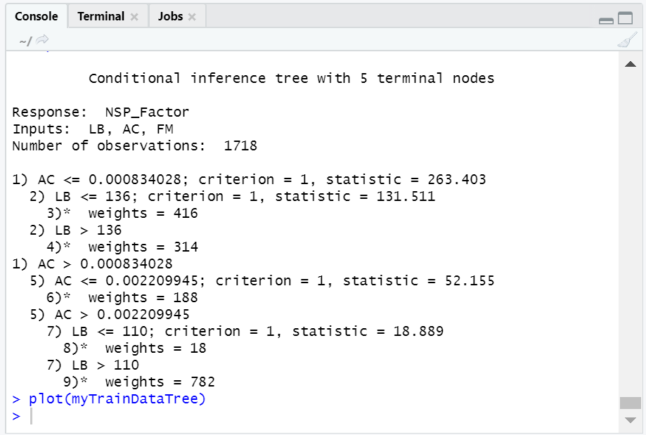
First Analysis - Decision Tree on Training Dataset
Infant’s health prediction using decision tree
1- Normal
2- Suspected
3- Pathological
Notes:
Creating the decision tree model using 3 independent variables- LB, FM and AC

Slide 6
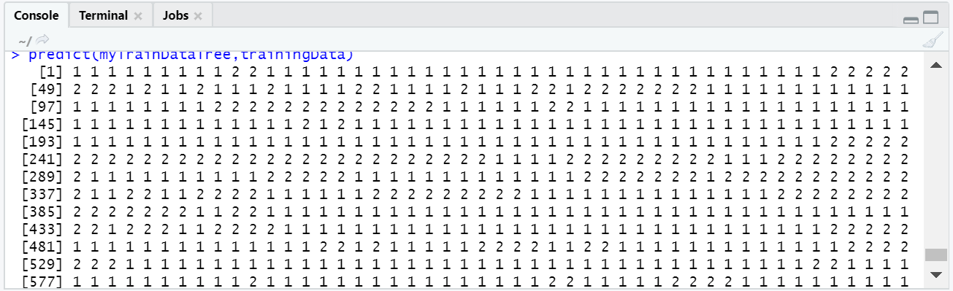
First Analysis- Decision Tree on Training Dataset cont.…
Normal
Suspected
Pathological
Notes:
Creating the decision tree model using 3 independent variables- LB, FM and AC

Slide 7
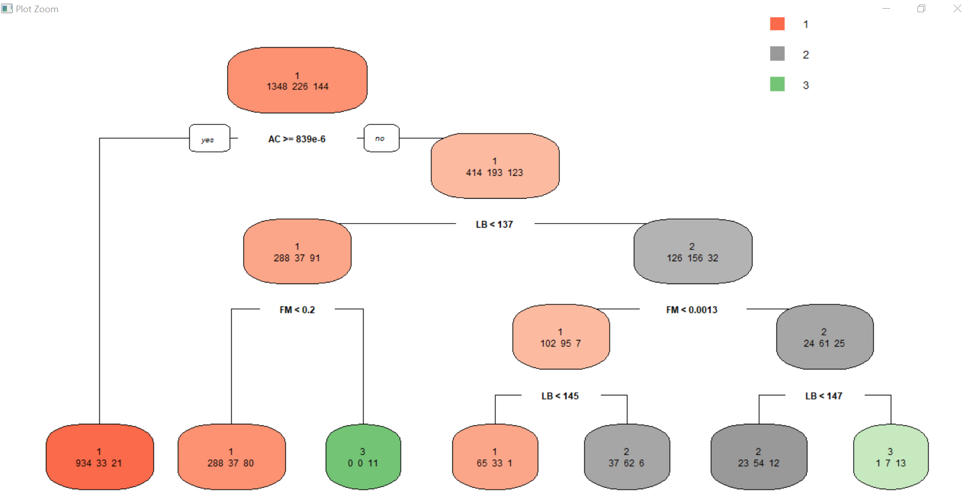
First Analysis- Decision Tree on Training Dataset cont.…
Infant’s health calculation prediction count of Training dataset
1- Normal
2- Suspected
3- Pathological
Notes:
Creating the decision tree model using 3 independent variables- LB, FM and AC

Slide 8
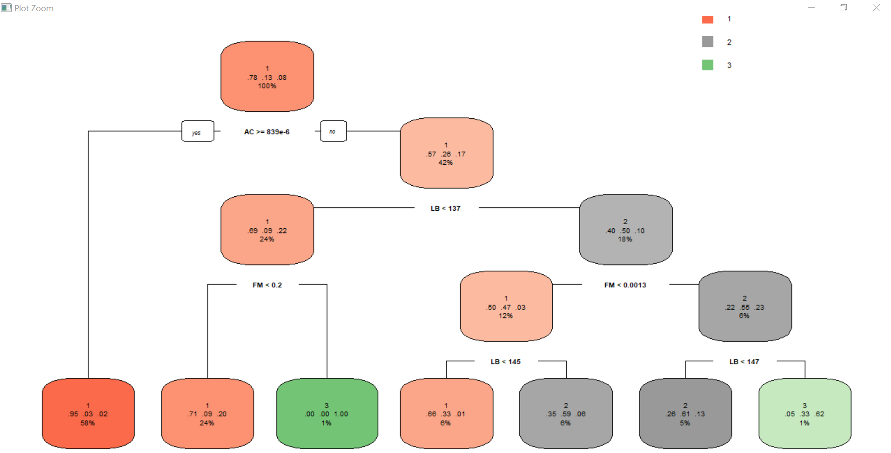
First Analysis- Decision Tree on Training Dataset cont.…
Infant’s health calculation prediction probability of Training dataset
1- Normal
2- Suspected
3- Pathological
Notes:
Creating the decision tree model using 3 independent variables- LB, FM and AC

Slide 9
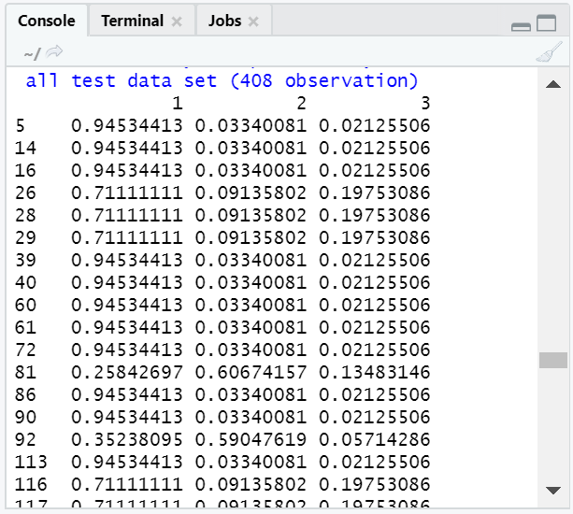
First Analysis- Decision Tree on TEST Dataset
Notes:
Creating the decision tree model using 3 independent variables- LB, FM and AC

Slide 10
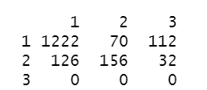
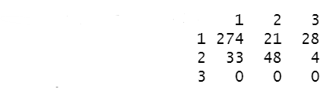
Decision Tree Model Evaluation
Training Dataset
Standard Error- (19.75%)
Test
Dataset
Standard Error- (21.07%)
Actual
Actual
Prediction
Prediction

Slide 11
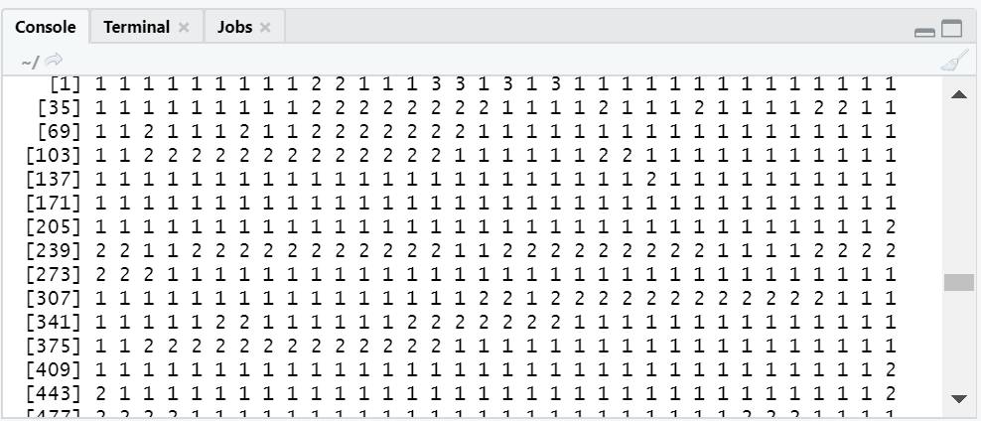
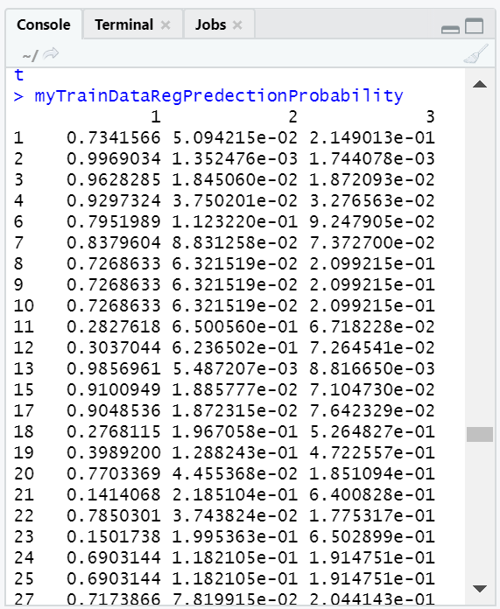
Second Analysis- Multinomial Regression on Training
Notes:
Creating the decision tree model using 3 independent variables- LB, FM and AC

Slide 12
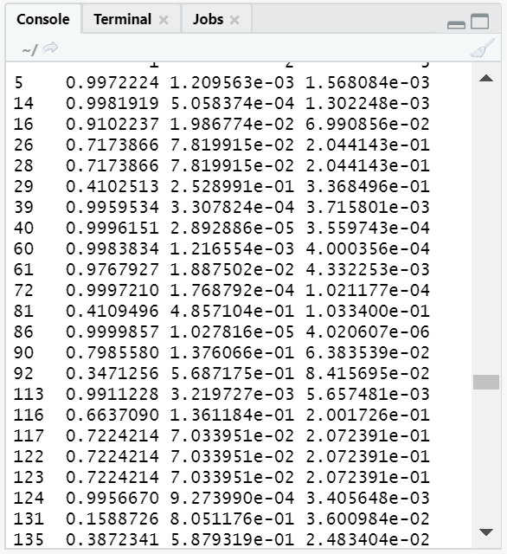
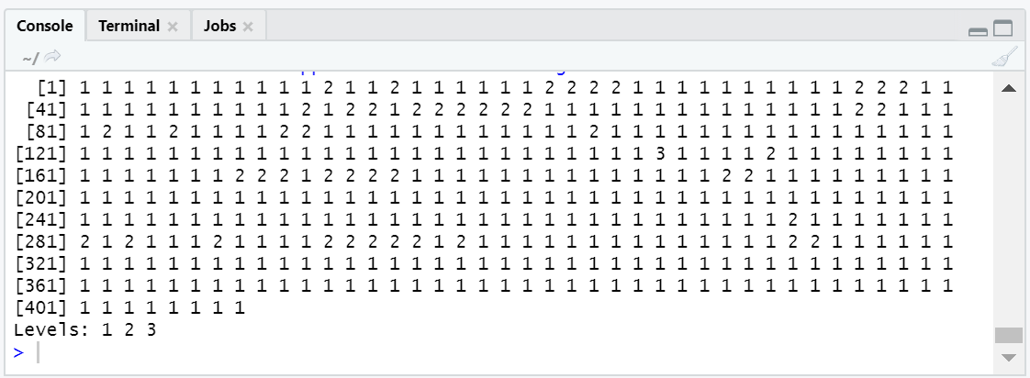
Second Analysis- Multinomial Regression on Test Dataset
Notes:
Creating the decision tree model using 3 independent variables- LB, FM and AC

Slide 13
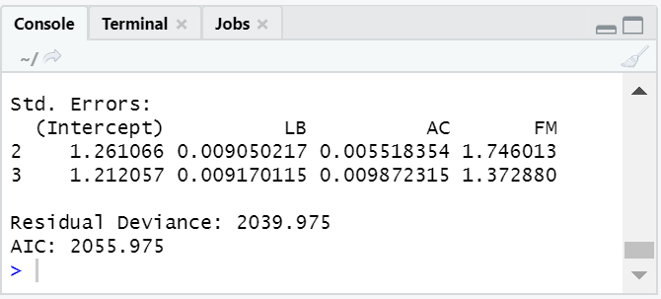
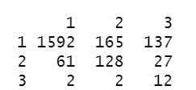
Multinomial Regression Model Evaluation
LB- FHR baseline (beats per minute)
2- Suspected
3- Pathological
AC- # of accelerations per second
FM- # of fetal movements per second
2- ~99.9%
3- ~99.9%
2- ~95%
3- ~92%
Actual
Standard Error- 18.53%
Accuracy Rate- 81.47%
Prediction

Slide 14
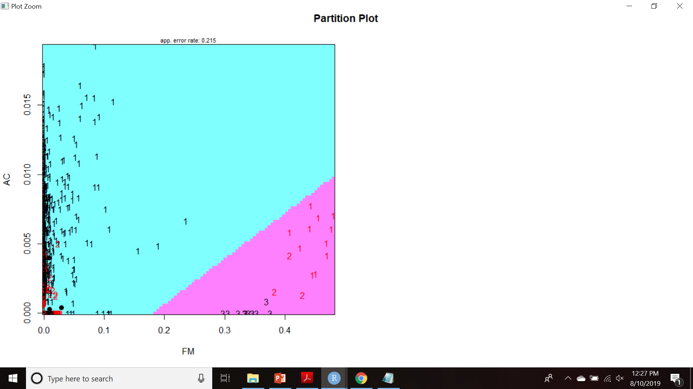
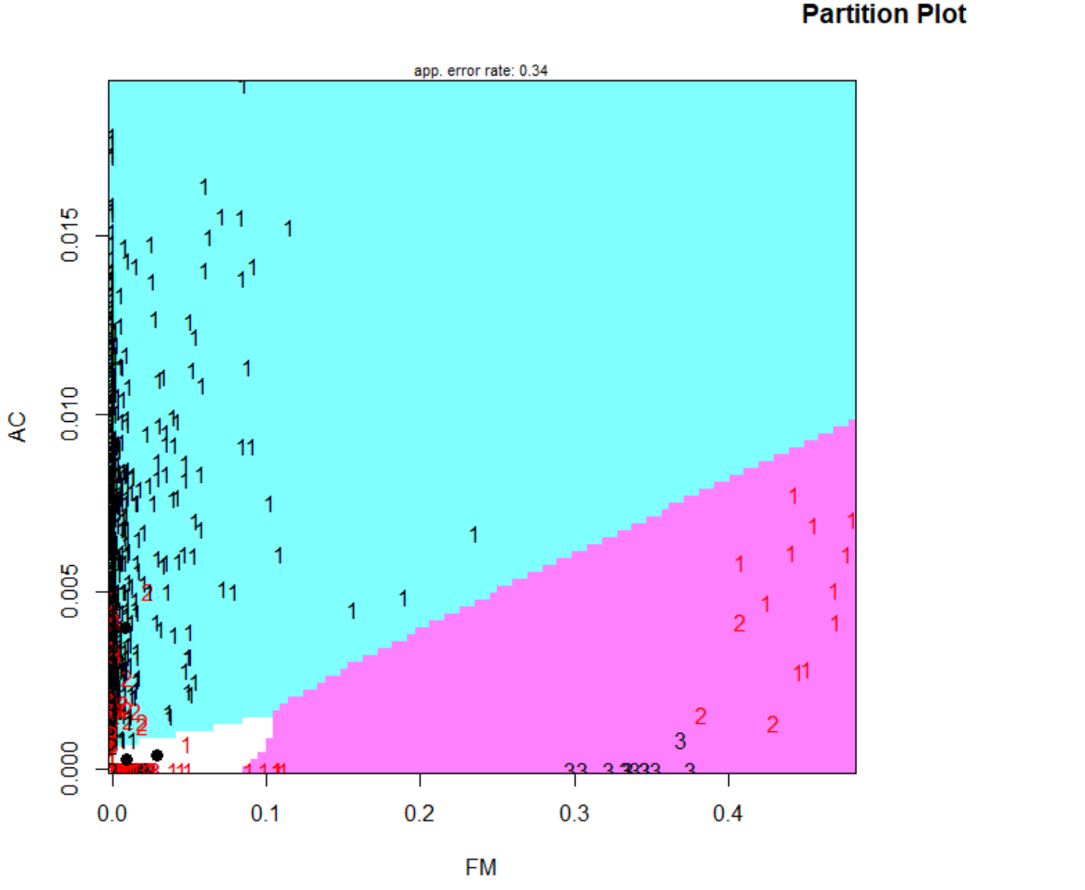
Third Analysis- Liner Discriminant Analysis
Linear Separation vs Quadratic Plot

Slide 15
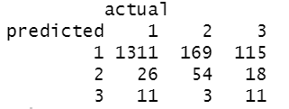
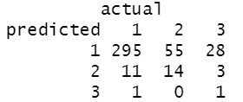
LDA Model Evaluation
Training Dataset
Accuracy~80%
Test
Dataset
Accuracy~ 76%

Slide 16
Conclusion
Decision Tree model observed as ~80% accurate and precise in predicting the infant’s heart condition based on several executions of model on training and test dataset.
The independent variables (LB and AC) used in multinomial regression analysis calculated with ~99% confidence while performing the foresaid regression analysis.
LDA model is evaluated with 80% accurate on train and 76% on test dataset however the plot could not clearly classify the categories for patients.

